Slide 1
Hi presenter! Read me before using!
This webinar resource is almost ready for you to use! Be sure to:
Look through and add custom information
Slide #2- Title slide (date)
Slide 3- Presenter information
Slide 5- Housekeeping items
Slide 21- Resources (optional)
Slide 22- Thank you slide
There are presenter notes to help guide you- feel free to edit these
This resource can be customized. Here are some examples of how you can personalize this slide deck to suit the needs of your educators and staff:
Replace our images with screen shots from your environment
Read through slides and ensure terms and jargon will resonate with your board policies/ tool names in your Brightspace environment (i.e. Assignments vs Dropbox, Announcements vs News etc)
Add additional information to slides specific to your district, including how this helps meet district goals, improvements plans, strategic plans etc
Include your district logo on slides or change the colors used to match your district branding

Slide 2
Using Learning Outcomes in Brightspace
<insert date>
© 2020 D2L Corporation
Notes:
This webinar will cover how to use Learning Outcomes in Brightspace

Slide 3
Presenter Name Title Company/Organization
@Twitter handle

Slide 4
Agenda
Importing expectations into your course
Adding expectations to Content, Assignments, Rubrics and Portfolio Artifacts
Assessing against expectations and checking student progress
Resources
Notes:
Today, we’ll be discussing Learning Outcomes in Brightspace and how we can import, add, assess and track against curriculum standards. Our agenda for today is:
Importing expectations into your course
Adding expectations to Content, Assignments, Rubrics and Portfolio Artifacts
Assessing against expectations and checking student progress
Resources

Slide 5
Housekeeping Items
How can people ask questions?
Webinar recording and slide deck will be available on ___________
Information about attendance
Notes:
This slide is for you to add Housekeeping Items particular to your District and this session.
It may include information about how attendees can ask questions, how they can access the webinar information after the session, or even how they confirm their attendance for the session (if applicable)

Slide 6
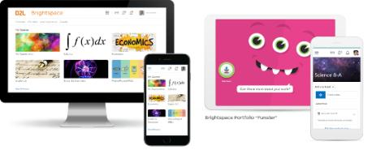
Understanding some terms...
Company:
D2L
Product:
Brightspace
Online Community:
Brightspace Community
Notes:
This is a useful slide to ensure everyone understand the terminology used when discussing Brightspace.
It would be helpful to personalize this slide to include any District specific information, especially if your District as a different branding for “Brightspace.” This will help attendees when they see resources about “Brightspace” to know that this is what your District is using as well but has branded differently.

Slide 7
Exceptional student experiences and outcomes
Equity for all students
Meaningful connections with parents
Why Educators
Brightspace
Tools teachers love
Worry-free technology
More partner, less vendor
Notes:
Here’s why educators love Brightspace

Slide 8
Using Learning Outcomes in Brightspace:
Expectations
Content
Assignments & Rubrics
Portfolio
Class Progress
Purpose:
Purpose:
Purpose:
Purpose:
Purpose:
Add curriculum expectations to your Brightspace Course and author your own expectations for your course!
Add expectations to your learning activities to keep track of how many expectations you’ve covered!
Assess against expectations on Assignments, Rubrics (and more!)
Use Portfolio to capture evidence of learning while still being able to assess against expectations.
Anytime you assess against an expectation, it will aggregate in Class Progress, so that both you and your students can see how students are progressing against expectations over time!
Notes:
Use this slide to introduce some of the tools or features you will discuss and cover during the demo
**Be sure to confirm the terminology on this slide matches the language terms used in your District’s Brightspace environment

Slide 9
Learning Outcomes Demo
Learning Objectives:
You will be able to:
Import expectations into your course
Add expectations to Content
Add expectations to Assignments, Rubrics and Portfolio Artifacts
Assess against expectations
Track student progress against expectations
Notes:
Next we’ll head into a live demo to show you how to use Learning Outcomes in Brightspace
Note: The learning objectives on this slide can be personalized to meet the needs for your District and attendees

Slide 10
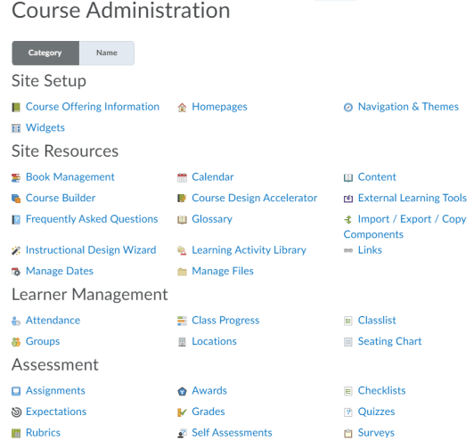
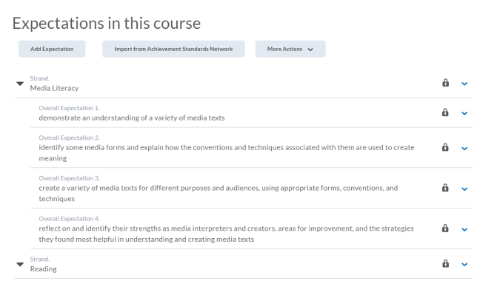
Import Expectations (1/2)
Use this to author your own custom expectations
2
1
From Course Admin, click “Expectations”
Click “Import from Achievement Standards Network”
Notes:
This slide can serve as a resource for your educators & staff after the webinar. It can also serve to help with step by steps instructions if doing a live demo is not possible.
Another option is to let your attendees know these how-to slides are in the slide deck for them to reference, and hide the remaining slides during the live webinar, and unhide them prior to send the slide deck to your attendees after the webinar.

Slide 11
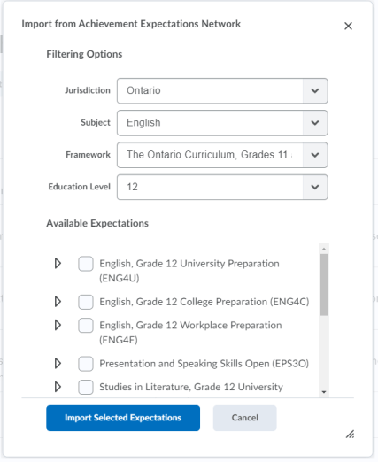
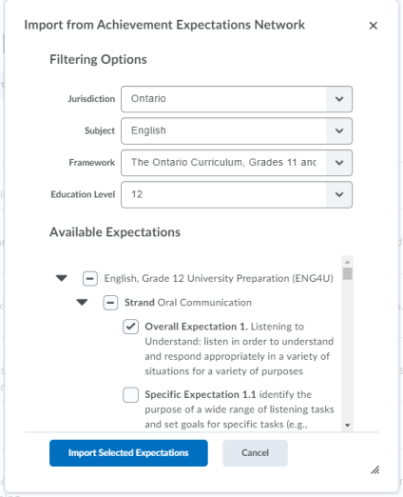
Import Expectations (2/2)
Use the filter options to find curriculum expectations for your jurisdiction, subject, framework an education level. Please note: only published curriculum and policies will be available
Click which curriculum you need for your course. Ticking the box will select all available expectations for that course
Optional: You can also drill down and choose which expectations you would like to import into your course
Click “Import Selected Expectations” and you’re all set!
3
4
5
6
Notes:
This slide can serve as a resource for your educators & staff after the webinar. It can also serve to help with step by steps instructions if doing a live demo is not possible.
Another option is to let your attendees know these how-to slides are in the slide deck for them to reference, and hide the remaining slides during the live webinar, and unhide them prior to send the slide deck to your attendees after the webinar.

Slide 12
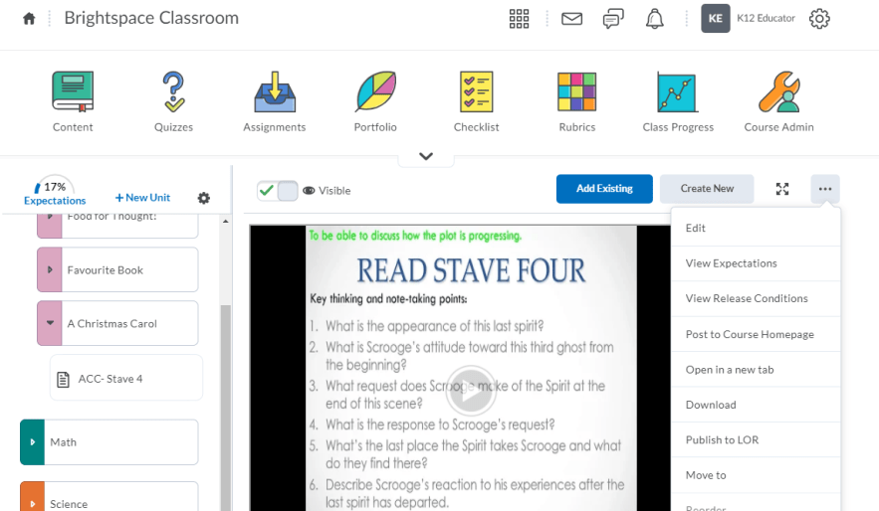
Adding Expectations to Content (1/2)
From Content, select which lesson, learning resource or activity you want to attach an expectation to.
Click the options menu, and select “View Expectations”
2
1
Notes:
This slide can serve as a resource for your educators & staff after the webinar. It can also serve to help with step by steps instructions if doing a live demo is not possible.
Another option is to let your attendees know these how-to slides are in the slide deck for them to reference, and hide the remaining slides during the live webinar, and unhide them prior to send the slide deck to your attendees after the webinar.

Slide 13
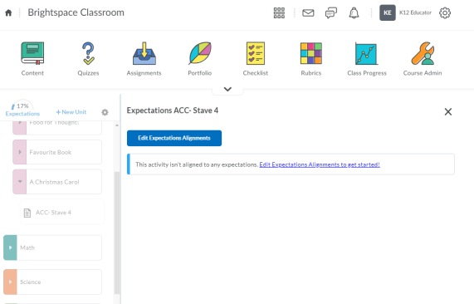
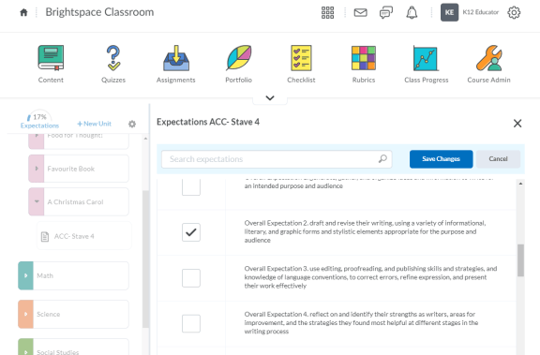
Adding Expectations to Content (2/2)
5
3
4
Click “Edit Expectations Alignment”
Browse or search for the applicable standard(s). Click the box beside the expectation you want to select.
Save changes and the expectations have been added.
Notes:
This slide can serve as a resource for your educators & staff after the webinar. It can also serve to help with step by steps instructions if doing a live demo is not possible.
Another option is to let your attendees know these how-to slides are in the slide deck for them to reference, and hide the remaining slides during the live webinar, and unhide them prior to send the slide deck to your attendees after the webinar.

Slide 14
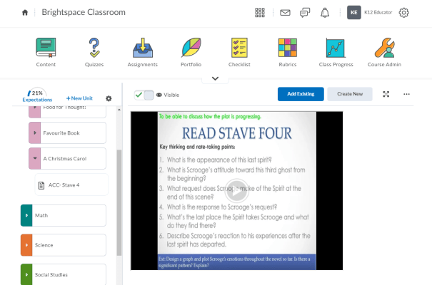
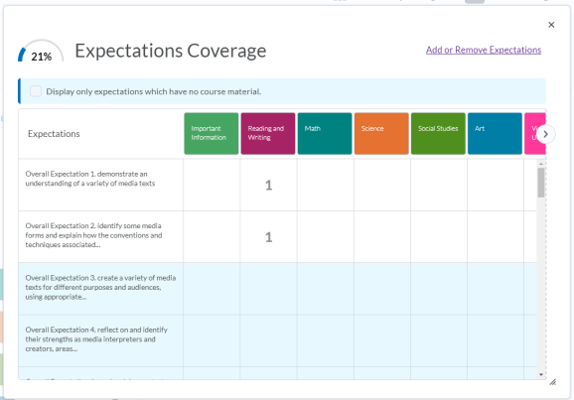
See Aligned Expectations at a Glance
3
1
2
See how many expectations have been covered here. Click the Expectations widget to see where expectations have been aligned.
Browse to see how many times an expectation has been aligned to a Unit/Module.
Tip: Use this to see which expectations have not yet been aligned to any learning material.
Notes:
This slide can serve as a resource for your educators & staff after the webinar. It can also serve to help with step by steps instructions if doing a live demo is not possible.
Another option is to let your attendees know these how-to slides are in the slide deck for them to reference, and hide the remaining slides during the live webinar, and unhide them prior to send the slide deck to your attendees after the webinar.

Slide 15
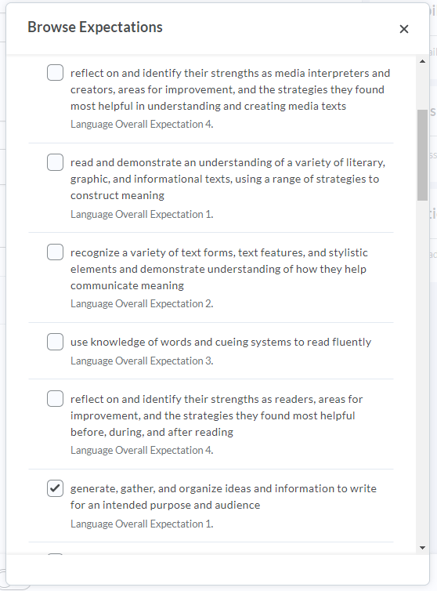
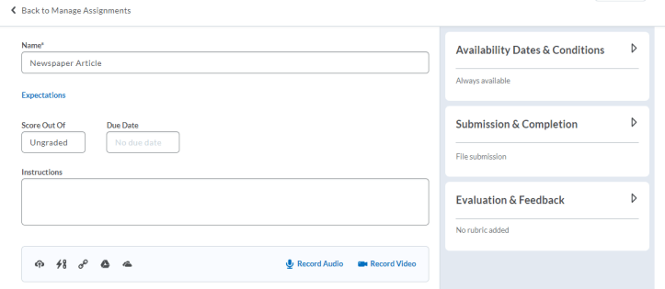
Add an Expectation to an Assignment
1
2
3
Click “Expectations”
Browse and select the expectation(s) you like to include.
Click the “Add” button.
Notes:
This slide can serve as a resource for your educators & staff after the webinar. It can also serve to help with step by steps instructions if doing a live demo is not possible.
Another option is to let your attendees know these how-to slides are in the slide deck for them to reference, and hide the remaining slides during the live webinar, and unhide them prior to send the slide deck to your attendees after the webinar.

Slide 16
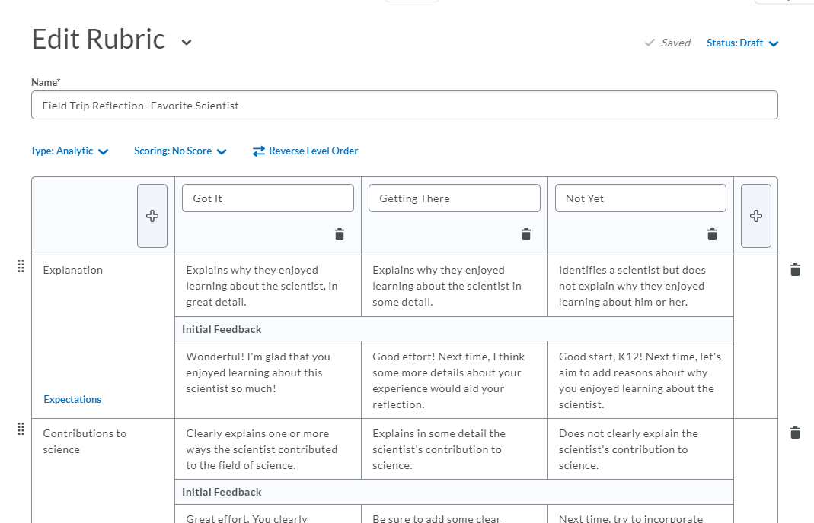
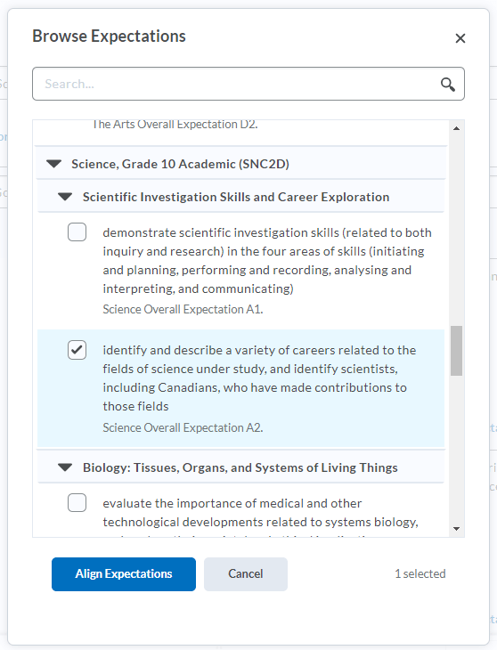
Add an Expectation to a Rubric
2
1
3
Click “Expectations”
Browse and select the expectation(s) you like to include
Click the “Align Expectations” button.
Notes:
This slide can serve as a resource for your educators & staff after the webinar. It can also serve to help with step by steps instructions if doing a live demo is not possible.
Another option is to let your attendees know these how-to slides are in the slide deck for them to reference, and hide the remaining slides during the live webinar, and unhide them prior to send the slide deck to your attendees after the webinar.

Slide 17
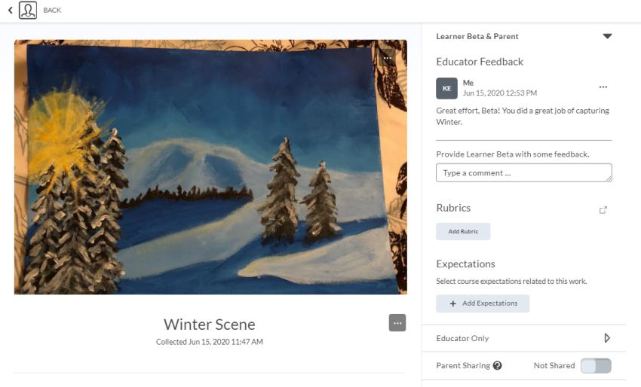
Add a Standard to a Portfolio Artifact (1/2)
1
Click “Expectations”
Notes:
This slide can serve as a resource for your educators & staff after the webinar. It can also serve to help with step by steps instructions if doing a live demo is not possible.
Another option is to let your attendees know these how-to slides are in the slide deck for them to reference, and hide the remaining slides during the live webinar, and unhide them prior to send the slide deck to your attendees after the webinar.

Slide 18
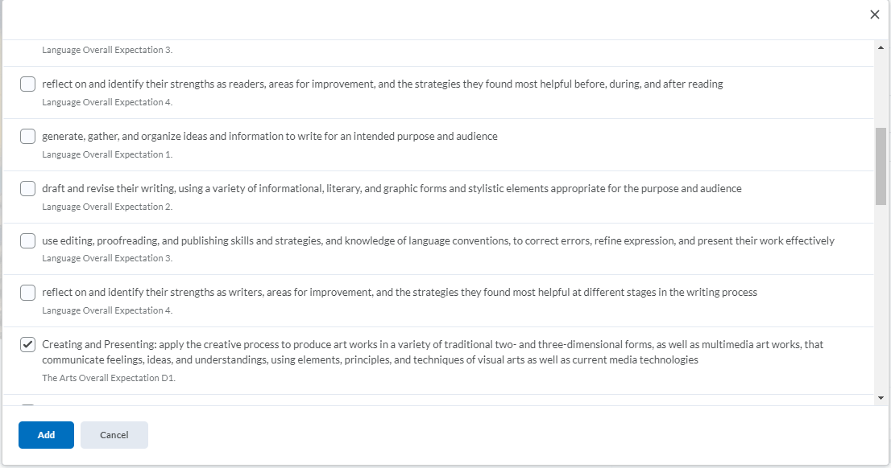
Add a Standard to a Portfolio Artifact (2/2)
2
3
Browse and select the expectation(s) you like to include
Click the “Add” button.
Notes:
This slide can serve as a resource for your educators & staff after the webinar. It can also serve to help with step by steps instructions if doing a live demo is not possible.
Another option is to let your attendees know these how-to slides are in the slide deck for them to reference, and hide the remaining slides during the live webinar, and unhide them prior to send the slide deck to your attendees after the webinar.

Slide 19
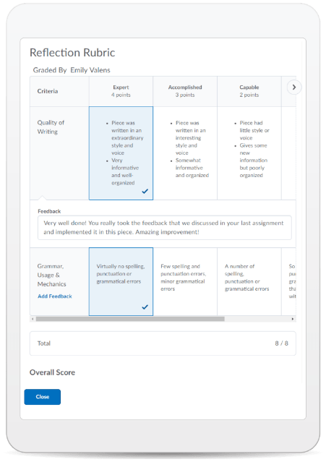
Learning Objectives:
You will be able to:
Import expectations into your course
Add expectations to Content
Add expectations to Assignments, Rubrics and Portfolio Artifacts
Assess against expectations
Track student progress against expectations
© 2020 D2L Corporation
Notes:
Awesome! We have accomplished all our learning objectives!

Slide 20
Give This a Try!
Import expectations into your course.
Add expectations to one of your Rubrics or create a Rubric and add expectations to your success criteria.
Notes:
Looking on how to get started? Give one of these take away activities a try!

Slide 21
Resources
Brightspace Quick Start Guide K-12
D2L Parent and Guardian Support Site
Edit Course Standards Alignment
Import Standards from Course Admin
Locate Gaps in Course Standards Coverage
Notes:
This page has resources specifically on Learning Outcomes. This is also where District specific resources can be added.

Slide 22
Tutorial Videos
Communication and Collaboration | Organizing Course Materials | Documenting Student Learning | Feedback & Assessment
Announcements Activity Feed -Add Attachments and Links to Posts -Create an Assignment Post in Activity Feed -Customize Notifications for Activity Feed -For posting a message -Optimize Activity Feed Discussions | Content/Lessons Tool -Getting Started with Lessons for Instructors -Lessons: Add a New Unit and Lesson -Lessons: Add New Materials -Lessons: Reorder Units, Lessons, Folders, and Materials -Lessons: Attach a Release Condition Groups -Creating Groups -Creating Individual Student Groups -Creating Unique Learner Pathways | Brightspace Portfolio -Review and Approve Portfolio Items -Oversee and View Individual Portfolios -Brightspace Portfolio: Bring Your Own Device (for learners) -Portfolio AT HOME Assignments Discussions Quizzes -Quiz Question Converter | Rubrics -Create an Analytic Rubric -Create a Holistic Rubric Grades -Entering Grades -Associate an Activity with a Grade Item -Create a Grade Scheme Standards/Expectations -Standards: Import Standards from Course Admin Assessing or Evaluating Against Expectations Quick Eval
Notes:
There are also many quick tutorial videos available! These resources are organized pedagogically. Every underlined item is linked to a tutorial video

Slide 23
Thank you!
@Twitterhandle
#districthashtag
#D2LK12
Notes:
Thank you so much for joining us today!
If you have any questions or need any help, please consult or contact:
We’d love to see all the awesome ways you’re using Brightspace! Use our District hashtag and/or #D2LK12 so we can all learn from each other and share great ideas of how to use Brightspace to support teaching, learning and, most importantly, our students!

